Slide 1
Antenna Alternatives
Nick Hall-Patch
IRCA-NRC-WTFDA-DecalcoMania Convention 2016

Slide 2
Antenna Alternatives
An alternative to THE antenna:
The Double Kaz (DKaz)
good directivity within a limited space

Slide 3
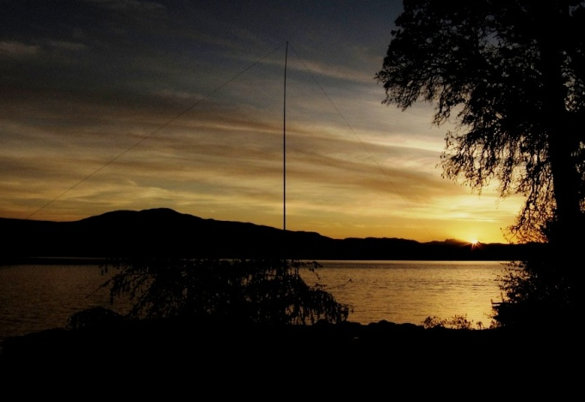
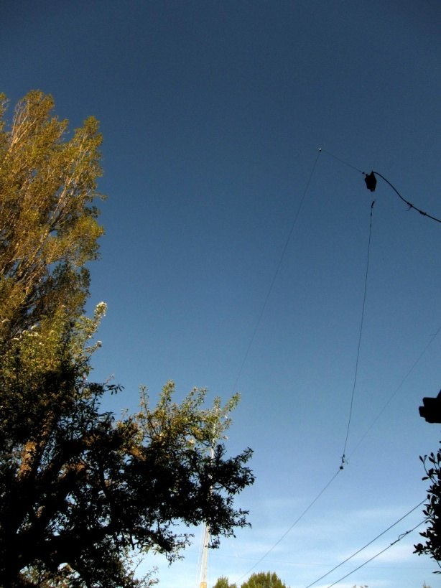
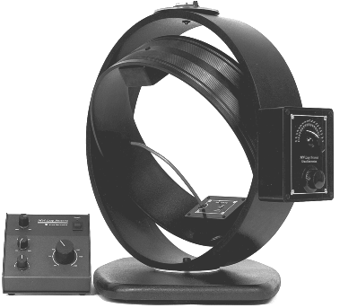
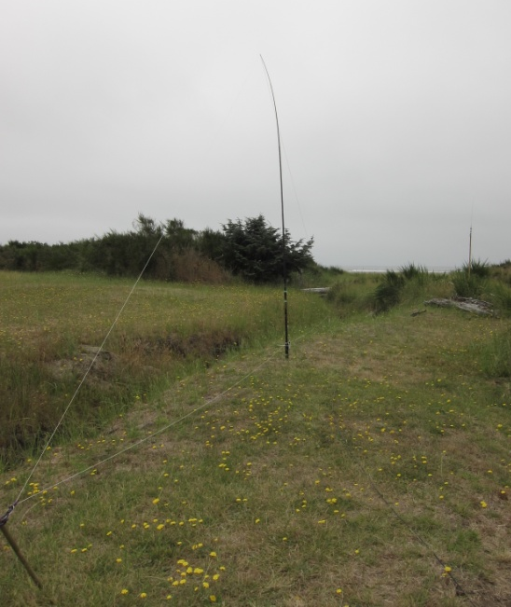
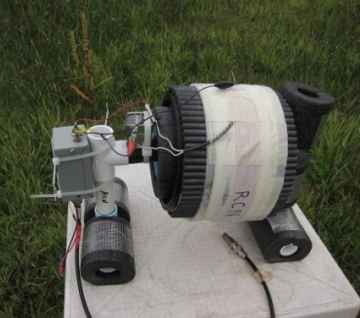
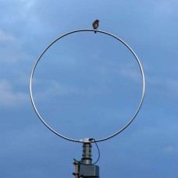
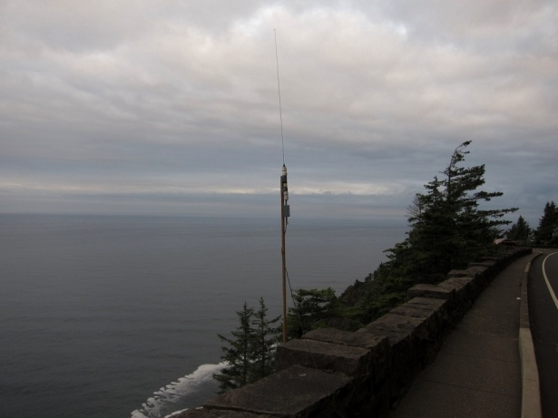
Antenna Alternatives
So, what’s the alternative?

Slide 4
Antenna Alternatives
What might one need in an antenna?
Ability to pick up signals
Directionality?
Wide frequency coverage?

Slide 5
Antenna Alternatives
Limitations to one’s antenna choices
small footprint?
low cost?
avoidance of local noise problems?
strong local signals?
will this be a temporary or stealth antenna?

Slide 6
Antenna Alternatives
Lots of receiving antennas from which to choose
Omnidirectional
Bidirectional
Unidirectional

Slide 7
Antenna Alternatives -- omnidirectional
Omnidirectional antennas
-----tend to be a vertical antenna or a variation
vertical wire (transformer coupled )
random wire
active whip

Slide 8
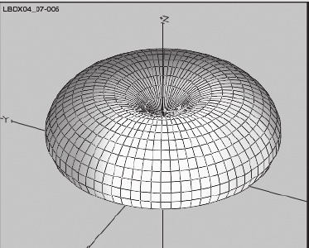
Antenna Alternatives -- omnidirectional
Vertical antennas
-----not exactly omnidirectional

Slide 9
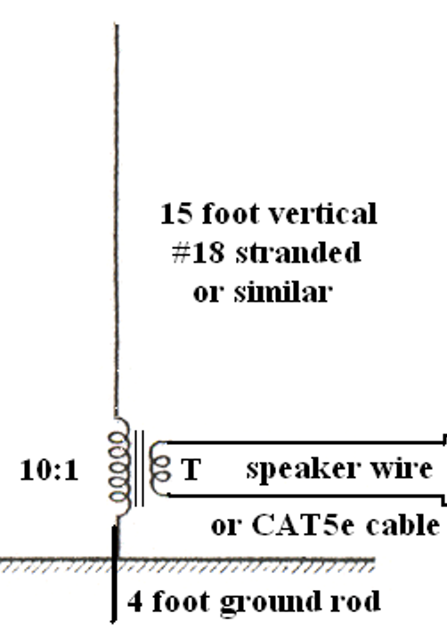
Vertical antennas
Antenna Alternatives -- unidirectional

Slide 10
Antenna Alternatives -- omnidirectional
Vertical antennas
----transformer coupling to feedline is best, 15 to 30’
advantages:
small footprint
inexpensive and fairly easy to build
broadband
can be quite sensitive
resistant to feeder conducted electrical noise
disadvantages:
better sensitivity requires more vertical height
a better quality ground delivers better signal

Slide 11
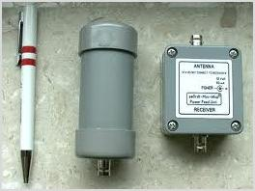
Active whip
Antenna Alternatives -- unidirectional

Slide 12
Antenna Alternatives -- omnidirectional
Active whip
--usually a small antenna element <4’ long, plus amplifier
advantages:
small footprint
does not need a ground connection for operation
broadband
sensitive
can be homebrewed
disadvantages:
requires placement away from nearby objects
generally sensitive to local electrical noise
trade off between sensitivity and strong signal handling
can be costly

Slide 13
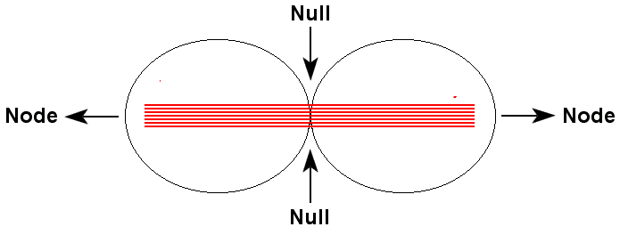
Antenna Alternatives -- bidirectional
Bidirectional antennas
For the home user, these are likely to be loop antennas
used for nulling interfering stations, but also for direction finding

Slide 14
Bidirectional antennas
tuned loop antennas
broadband loop antennas

Slide 15
tuned loop antennas
ferrite-core
air-core

Slide 16
Antenna Alternatives -- bidirectional
tuned loop
advantages:
small footprint
small enough to be used indoors, particularly ferrite-core loops
surprisingly good sensitivity
can rotate to find direction of a signal or to null out interference
home construction possible
Tuned loop disadvantages:
single frequency tuning
is sensitive to local electrical noise in nearby residential wiring

Slide 17
Antenna Alternatives -- bidirectional
Broadband loop antennas

Slide 18
Antenna Alternatives -- bidirectional
Broadband loop
advantages:
wideband response
inexpensive home construction is possible
can be mounted near the ground, and draped over foliage
can be positioned to null interference
can be placed away from noise sources
relatively insensitive to local noise
disadvantages:
low signal output, often requires preamplifier
need to be aware of nulls when placing antenna

Slide 19
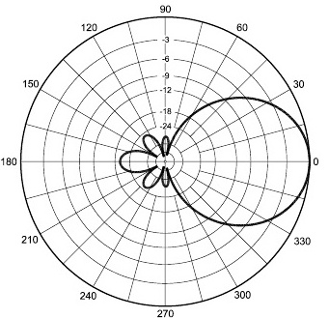
Antenna Alternatives -- unidirectional
unidirectional antennas
--choices?
Narrow lobe in just one direction

Slide 20
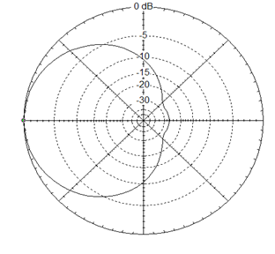
Antenna Alternatives -- unidirectional
unidirectional antennas
--choices?
Narrow lobe in just one direction
Broad front lobe, broad rear null

Slide 21
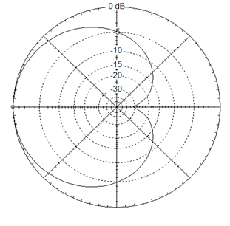
Antenna Alternatives -- unidirectional
unidirectional antennas
--choices?
Narrow lobe in just one direction
Broad front lobe, broad rear null
Sharp null in one direction, broad lobe in other
At least one of the above criteria can be provided by a family of unidirectional antennas, the “non-resonant terminated loop”

Slide 22
Antenna Alternatives -- unidirectional
non-resonant terminated loops:
Ewe
K9AY
Flag
Kaz / terminated delta
Conti “superloop”
---these are mostly refinements of Earl Cunningham’s Pennant antenna derived from Floyd Koontz’ Ewe antenna
Notes:
)

Slide 23
Antenna Alternatives -- unidirectional
non-resonant terminated loops
fit in a city lot, though can be somewhat larger
are terminated with approximately 1kΩ resistance opposite the signal take-off point
termination faces towards direction of null
termination can be variable and remotely controllable
signal take-off is via transformer or preamplifier
are broadbanded

Slide 24
The “Ewe”
Antenna Alternatives -- unidirectional

Slide 25
Antenna Alternatives -- unidirectional
Ewe
advantages:
strongest signal output for its size of all the unidirectional antennas
simple construction for the homebrewer
disadvantages:
requires two vertical supports and two ground rods
needs a good ground

Slide 26
The K9AY
Antenna Alternatives -- unidirectional

Slide 27
Antenna Alternatives -- unidirectional
K9AY
advantages:
single vertical support
small footprint
can be homebrewed
a crossed pair can provide a multi-directional array
array is commercially available
disadvantages
needs a good ground or multiple radials
likely needs a preamplifier for MW
array is fairly complex if home built

Slide 28
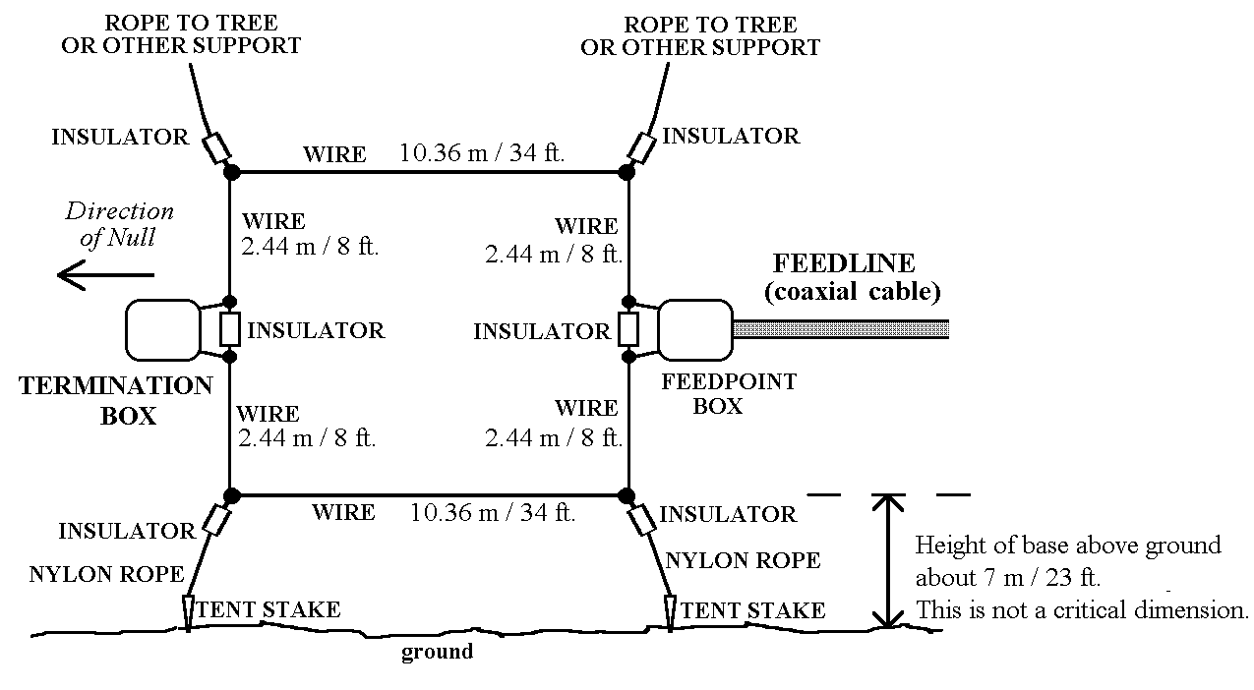
The Flag
Antenna Alternatives -- unidirectional

Slide 29
Antenna Alternatives -- unidirectional
Flag
advantages:
better signal output compared with a delta with the same linear footprint
fairly easily homebrewed
no grounding required
disadvantages
two vertical supports
termination and output feedline are halfway up the vertical elements

Slide 30
The “Kaz” / terminated delta
Antenna Alternatives -- unidirectional

Slide 31
Antenna Alternatives -- unidirectional
Kaz /terminated delta
advantages:
single vertical support
no grounding required
easily scaled up or down
easily homebrewed
easily assembled and taken down
disadvantage:
slightly lower output signal for same footprint compared with Flag or Ewe

Slide 32
The Conti “Superloop”
Antenna Alternatives -- unidirectional

Slide 33
Antenna Alternatives -- unidirectional
Conti “Superloop”
advantages:
not ground dependent
easily scaled up or down
easily homebrewed
fairly easily assembled and taken down
signal output higher than a delta with the same linear footprint
disadvantages:
slightly lower output signal for same footprint compared with Ewe
two vertical supports required

Slide 34
Antenna Alternatives -- really?
Is a non-resonant terminated loop an alternative to a DKaz?
All non-resonant terminated loops give much the same depth of nulls to stations off the back end of the antenna.
These nulls are in the range of 10-25dB, sometimes even deeper, depending on termination resistance and depending on how far skewed away is the null from directly off the back of the loop
Also, signal strengths off the front end of these loops are within a couple of dB of what a DKaz can deliver.
So, how good are they compared to a DKaz?

Slide 35
Antenna Alternatives -- really?
Is a non-resonant terminated loop an alternative to a DKaz?
DKaz
The DKaz is a gold standard DX antenna...
Flag
But....can a little Flag go head-to-head with a big DKaz?
(or is it an unfair contest?)

Slide 36
Antenna Alternatives -- really?
A standard sized Flag antenna was compared with a 160 foot long DKaz at Grayland, WA, both aimed at 270 degrees
The DKaz signal is heard first in the following NetSDR playback, followed by the Flag’s
Listen to and watch for the difference on 4RN-792.

Slide 37
Antenna Alternatives -- really?

Slide 38
Antenna Alternatives -- really?
We should really care most about the “carrier to noise” ratio.

Slide 39
Antenna Alternatives -- really?
If the signal strength is averaged for 25 seconds either side of the changeover point from DKaz to Flag for both carrier and for noise in the recorded NetSDR file, the following relationships are found:
 | Carrier 792.002kHz | Noise 793.000kHz | C/N ratio
Flag average signal strength | -92.0 dBm | -132.1dBm | 40.1 dB
DKaz average signal strength | -94.5 dBm | -139.2dBm | 44.7dB
So the DKaz has 4.6 dB better C/N than Flag, at least for 4RN-792
Note that the Flag’s absolute strength on 792 is actually slightly better than the Dkaz’

Slide 40
Antenna Alternatives -- really?
If we look at example horizontal patterns generated by EZNEC antenna modeling software, we can see subtle differences in response off the back ends of the Flag and of the 160’ DKaz
Flag
DKaz
Straightforward front to back ratio looks similar, but the DKaz has generally less response, especially over the back facing 180 degree slice.
Is there a way to quantify this relationship in clearer terms than front to back ratio?

Slide 41
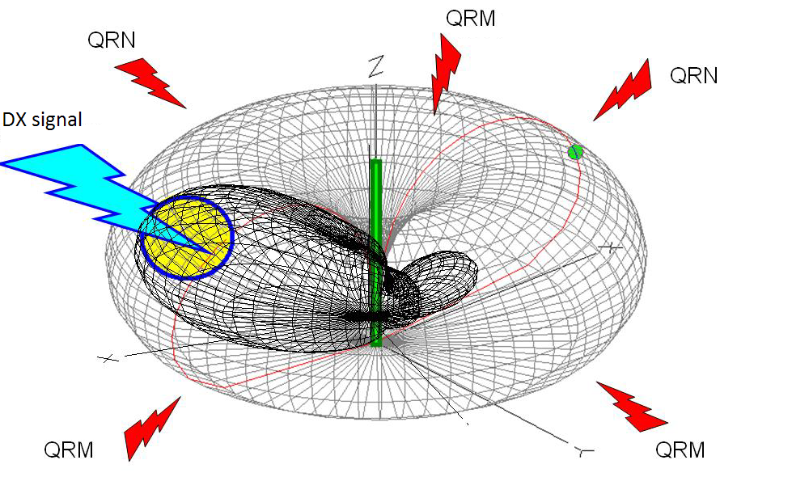
Antenna Alternatives -- really?
In the radio amateur world, Receiving Directivity Factor (RDF) is often used as such a measure:
RDF is an arbitrary number that can be defined as the ratio in the average signal level delivered by the antenna over +/-10 degrees from the point of maximum response both in altitude and in azimuth compared with the average signal delivered by the antenna from every direction.

Slide 42
Antenna Alternatives -- really?
EZNEC allows us to calculate RDF for a given antenna when a 3D pattern is calculated
The Flag has an RDF of 7.8dB
The DKaz has an RDF of 9.6dB
---an advantage of 1.8dB to the DKaz
This <2dB in an expression of antenna “goodness” doesn’t seem like much, but a couple of dB can make the difference between hearing DX and not hearing it in rough conditions.

Slide 43
Antenna Alternatives -- really?
We observed that the DKaz had 4.6 dB better C/N than Flag, not 1.8dB
RDF is arbitrary. There is at least one other measure of antenna “goodness”
A coastal DXer will often be happy to accept any signal arriving from overseas, so a derivation known as Directivity Merit Figure (DMF) may be preferable.
DMF compares an antenna’s average forward response in that +/-10degree “sweet spot” to the average signal response of the antenna to the half hemisphere of noise and interference that a coastal DXer would want to reject. In other words....

Slide 44
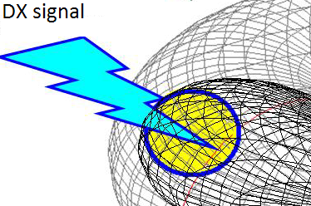
Antenna Alternatives -- really?
We observed that the DKaz had 4.6 dB better C/N than Flag, not 1.8dB
RDF is arbitrary. There is at least one other measure of antenna “goodness”
A coastal DXer will often be happy to accept any signal arriving from overseas, so a derivation known as Directivity Merit Figure (DMF) may be preferable.
DMF compares an antenna’s average forward response in that +/-10degree “sweet spot” to the average signal response of the antenna to the half hemisphere of noise and interference that a coastal DXer would want to reject. In other words,
The response from here:

Slide 45
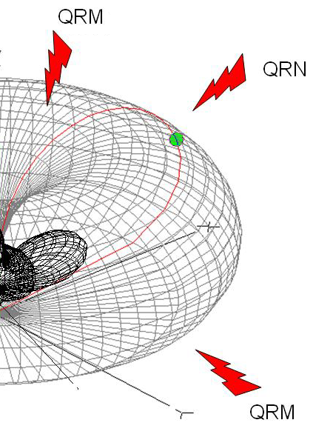
Antenna Alternatives -- really?
We observed that the DKaz had 4.6 dB better C/N than Flag, not 1.8dB
RDF is arbitrary. There is at least one other measure of antenna “goodness”
A coastal DXer will often be happy to accept any signal arriving from overseas, so a derivation known as Directivity Merit Figure (DMF) may be preferable.
DMF compares an antenna’s average forward response in that +/-10degree “sweet spot” to the average signal response of the antenna to the half hemisphere of noise and interference that a coastal DXer would want to reject. In other words,
The response from here:
compared with just the response from here:

Slide 46
Antenna Alternatives -- really?
A program called “LBDXview” calculates Directivity Merit Figure:
The Flag has a DMF of 12.9dB
The DKaz has a DMF of 19.3dB
---an advantage of 6.4dB to the DKaz, a little closer to the 4.6dB C/N that was observed on 4RN

Slide 47
Antenna Alternatives -- really?
DMF is also arbitrary, of course....but I think we can safely say...

Slide 48
Antenna Alternatives -- really?
DMF is also arbitrary, of course....but I think we can safely say...
There is no alternative
to the DKaz, at least for the DXpeditioner.
On the other hand, the non-resonant terminated loops such as the Flag or Superloop, are ideal for the space limited DXer

